Slide 1
Schema-Guided Paradigm for Zero-Shot Dialog
Shikib Mehri and Maskine Eskenazi
Presented by Amogh Mannekote and Vyom Pathak (Group 6)

Slide 2
Introduction/Motivation
Task oriented dialog systems -> User Goals for a Task
Dominant models -> Neural models as they can learn complex pattern using data driven approach
These models struggle for unseen dialog domains and tasks.
Research Question:
"How can a dialog system be extended to handle a new task, without collecting additional data?"

Slide 3
Difficulties of Zero-Shot Setting
Large-scale pre-training make great strides in domain adaptation across in different areas of NLP.
Generalization in end-to-end task-oriented dialog is still difficult in zero-shot settings because of dialog policy.

Slide 4
Traditional Dialog Systems
Three Tasks:
Understand the dialog history and identify any relevant user intents or slots.
Decide on the appropriate system action, according to a task- specific dialog policy.
Generate a natural language utterance corresponding to the system action.
Problems :
An E2E dialog model trained on several tasks, will implicitly learn the dialog policies from the data.
This is difficult for generalization to a new task in a zero-shot setting; it has no knowledge of the dialog policy for the new task.

Slide 5
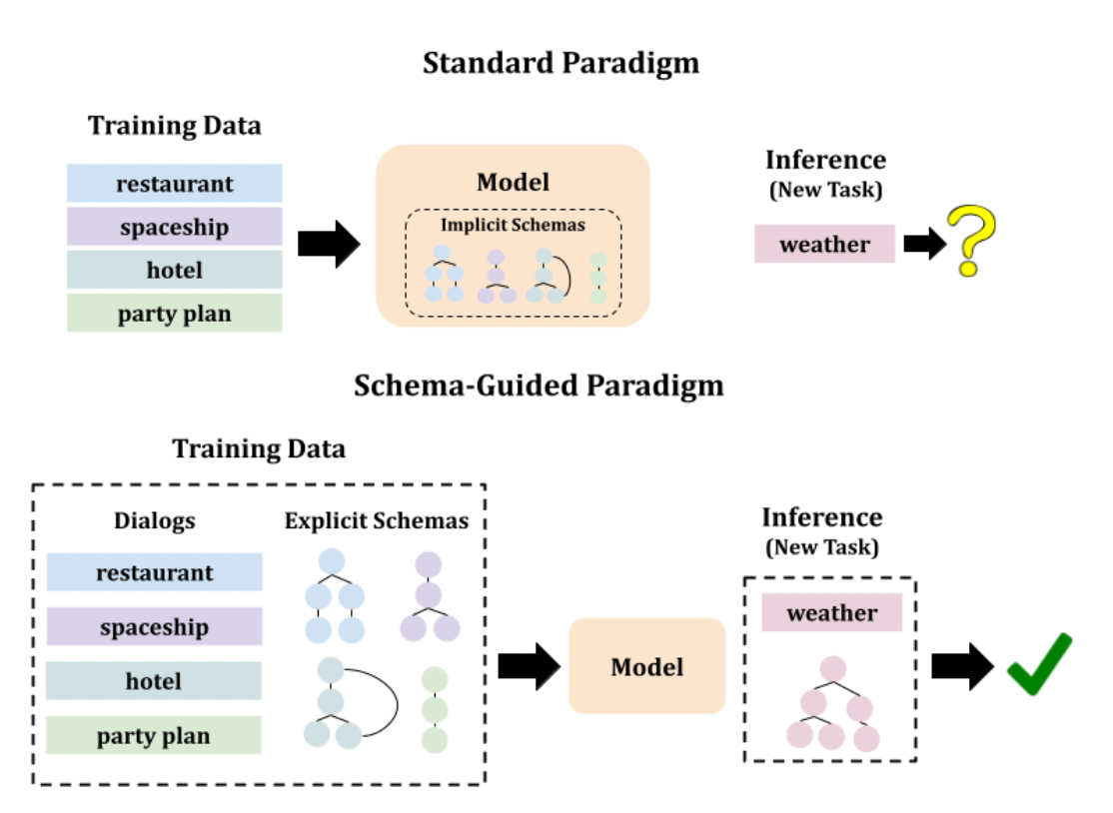
Schema-Guided Paradigms
Task-specific dialog policies to the model in the form of a schema graph.
System’s behaviour for a specific task
Transferring to a new task only requires new schema task with the model.
SAM -> +22 F1 Score

Slide 6
Related Work

Slide 7
Zero Shot Dialog
Zero-shot intent recognition
Shared embedding space for utterances and intent names [Chen et al. 2016].
Slot descriptions as model inputs [Bapna et al. 2017].
Zero-shot dialogue state tracking
Uses a dialogue state generator. Domain and slot descriptions as model inputs. [Wu et al. 2019].
Use a small number of examples to improve transferability [Shah et al. 2019].
BERT for encoding the utterances and the slot names [Rastogi et al. 2020a].

Slide 8
Zero Shot Dialog
Zero-shot end-to-end dialogue
Use domain descriptions. Context-in, Response-out. [Zhao et al. 2018].
Makes use of latent action spaces
Not well-researched due to difficulty in generalizing to unseen task policies
“We also argue that it is more efficient and natural for domain experts to express their knowledge in terms of domain descriptions rather than example dialogs.”

Slide 9
Schema-Guided Paradigm
Same philosophy as Plan-based Dialogue Systems of yesteryear
task-specific and task-agnostic components decoupled
system can be extended to a new task by updating the task specification
Dialogue structure (“schema”) can be either learned from data [Shi et al., 2019; Qiu et al., 2020; Xu et al., 2020; Hu et al., 2019] or manually handcrafted.

Slide 10
Task Definition

Slide 11
STAR Dataset
For studying transfer learning tasks.
24 different tasks - 13 different domains and 3 different types of dialogs:
happy single-task dialogs
unhappy single-task dialogs
multi-task dialogs
Amazon Mechanical Turk (AMT) workers with flow chart of pre-defined tasks.

Slide 12
Zero Shot Setting
Two Experiments:
Task-Transfer:
Train on n-1 tasks and test on the other one task
Domain-Transfer:
Train on n-1 domains and test on the other one domain

Slide 13
Methods
Next Action Prediction

Slide 14
Baseline
Dialog History -> BERT -> Vector Representations
Vector Representations -> Predict Next Action

Slide 15
Schema Representation
Task-Specific Dialog Policy
The baseline [Mosig et al. (2020)] schema-graph fails as it uses only system-utterance.
Extension to this by providing user-utterance
Properties of Schema Graph:
System actions are deterministic.
One-to-One mapping between system actions and system responses.

Slide 16
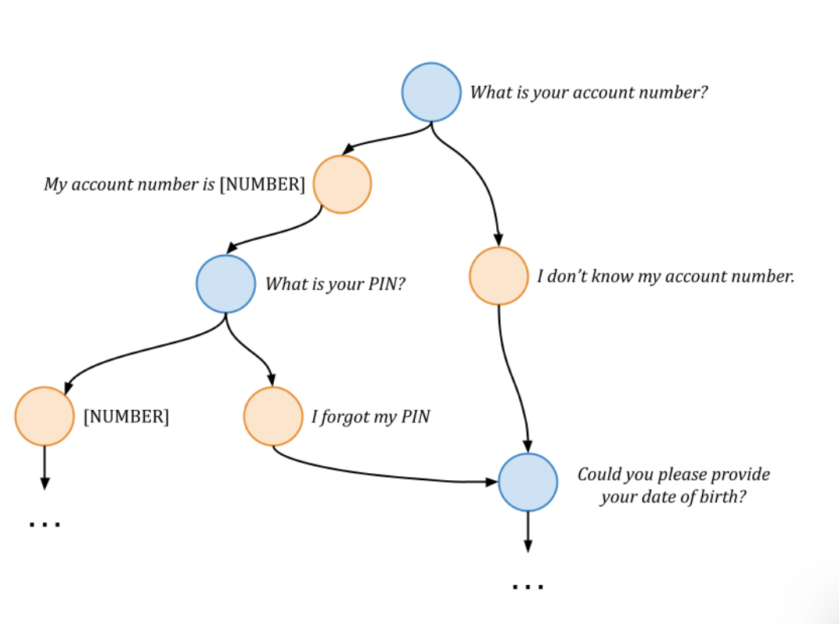
Example of Schema-Graph

Slide 17
Schema Attention Model
Attends between the dialogue history and the nodes of schema
Input: (dialogue history, schema) Output: probability distribution over all nodes in the schema graph
node u -> text(prev(u)) + text(u)
BERT used as the encoder

Slide 18
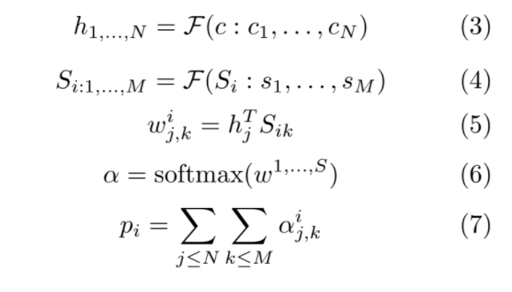
Schema Attention Model

Slide 19
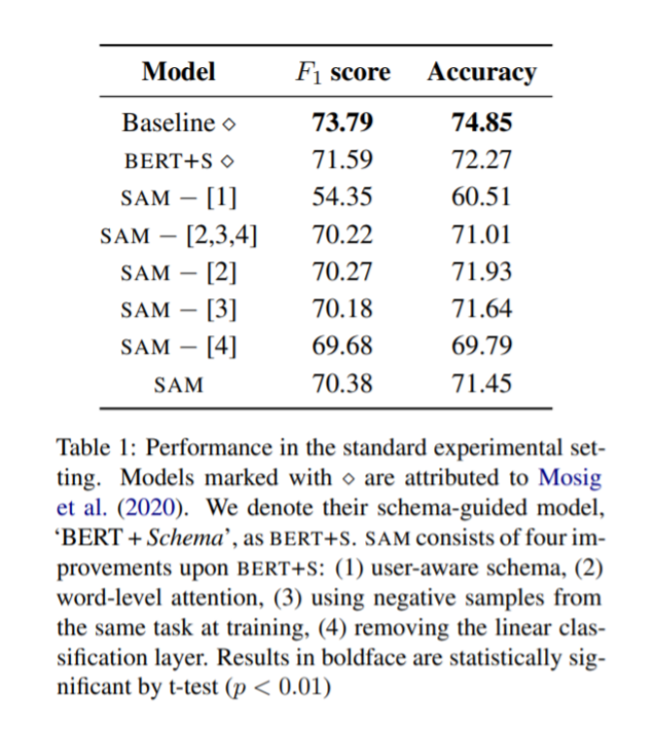
Results

Slide 20
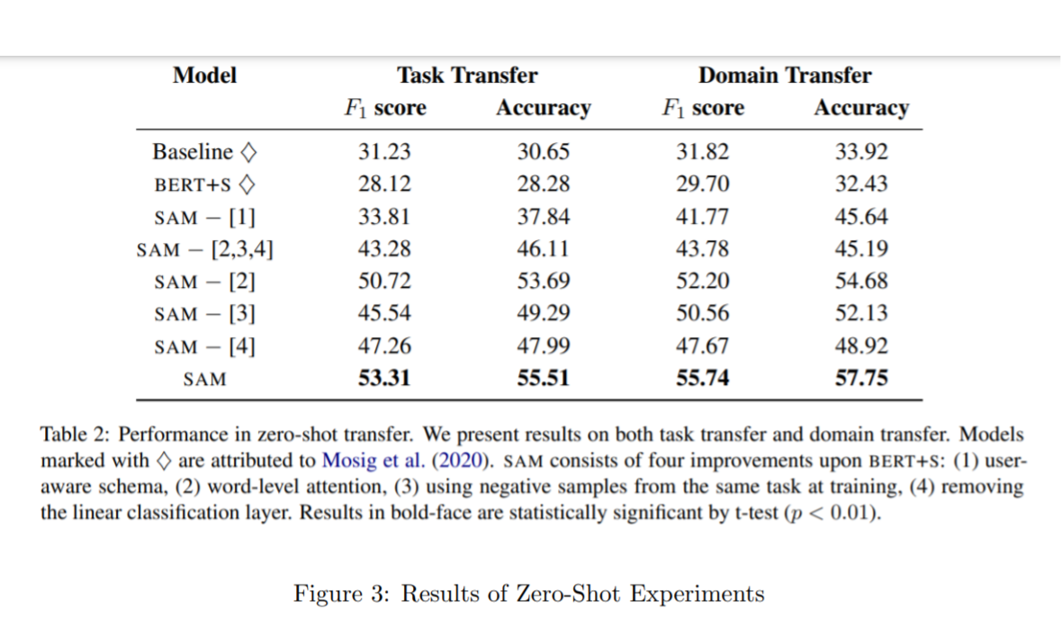
Zero-Shot Results

Slide 21
Conclusion
Results show the effectiveness of the schema-guided paradigm
Future work can look into:
Improved representation
Improved model architectures

Slide 22
Thank You

